Slide 1
Digital Design Records Taskforce
Co-chairs: Laura Schroffel and Jody Thompson
Other active members: Stefana Breitwieser, Aliza Leventhal, Talia Olshefsky, Jessica Quagliaroli, Sarah Schubert
Society of American Archivists Annual Meeting
August 3, 2019 - Austin, TX

Slide 2
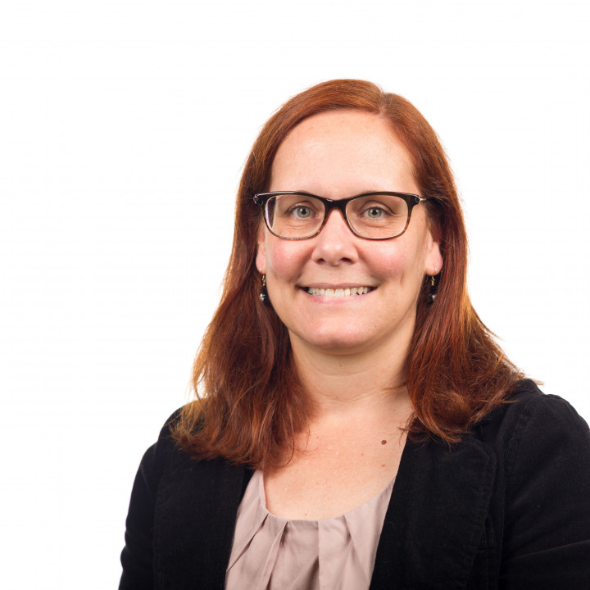
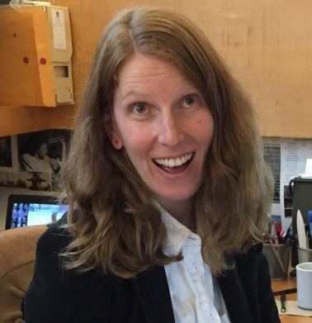
News
New Co-Chairs
Jody Thompson, Head of the Archives and Special Collections department and the Library's Preservation Manager at Georgia Tech
Laura Schroffel, Digital Archivist at the Getty Research Institute
Notes:
Beloved taskforce chair Aliza Leventhal took a break from managing the section in the beginning of 2019 after she accepted a new position as Library of Congress’ Assistant Section Head of Technical Services for the Prints & Photographs Division. But we are interested in changing leadership again in 2020 if anyone is interested in that role.

Slide 3
News
Two interesting developments for the Taskforce:
We changed our name from the CAD/BIM Taskforce to the Digital Design Records Taskforce.
We centralized all of our documentation and output into one account that can be organized/accessed as needed as management of the taskforce evolves.
digitaldesignrecordstaskforce@gmail.com
Notes:
Other news you might have noticed is that we changed our name from the CAD/BIM Taskforce to the Digital Design Records Taskforce. We felt that limiting the taskforce name to only Cad and Bim did not fully express the breadth of the taskforce’s interests, which is truly to support research and inquiry into all aspects of the archival practice surrounding all types of digital design records.
Also as I mentioned earlier we had a change in mangement which resulted in a need to centralize all of our documentation and output into one account so that it can be organized/accessed as needed as management of the taskforce evolves. And while we do have an email attached to our account it is still probably best to reach out to members directly if you have any questions.

Slide 4
Background
Founded 2012
Bibliography 2012-2014 (2 Members)
Surveys 2015-2016 (11 Members)
Glossary & Info. Interviews 2016-2017 (7 Members)
FAQ, SAA Research Forum paper 2017-2018 (3 Members)
Archival Description project and Deed of Gift Matrix 2018-2019 (7 Members)
Notes:
Glossary: [presented last year, why the TF went another direction] FAQ-[Why we selected to work on this, and then went another direction]

Slide 5
2017-2018
FAQ
There are myriad challenges to properly preserve digital content but the taskforce wanted to narrow down the most important or institutionally pressing ideas that were directly related to digital design files. The goal was to have a universal point of reference to broaden the baseline knowledge level for all and similarly communicate that institutions are not dealing with these challenges alone.
Notes:
I wanted to speak briefly about the FAQs which were developed beginning in 2017 and were part of the focus of the presentation given last year. The goal was to have a universal point of reference to broaden the baseline knowledge level for all and similarly communicate that institutions are not dealing with these challenges alone.

Slide 6
2017-2018
FAQ
The FAQs were divided into three crucial categories: technology (standards; workflows: digital preservation practice; software dependencies), access (subject knowledge; file types; preservation; donor agreement/administrative), and description (identifying standards, vocabularies, and ontologies to be used for describing digital design files).

Slide 7
2019
Results of FAQ
The FAQ was never formally completed. But it provided a platform for lively discussion and became a springboard for writing and developing new projects. It was very much a dynamic document that never achieved publishing level conditions.
The FAQs were sunsetted this year but continue to serve as a reference and resource to the Taskforce.

Slide 8
Deed of Gift
One project that was springboarded from the FAQs concerned deeds of gift. It was presented last year at the section meeting and at the 2018 SAA Research Forum. The taskforce explored how repositories can, and do, leverage the deed of gift to address the complex challenges specific to collecting born digital architecture and design records.
The peer reviewed paper resulting from our research and analysis “Deeds of Gift as a Tool to Facilitate Born Digital Design File Processing and Preservation” is available here: https://www2.archivists.org/am2018/research-forum-2018/agenda#peer

Slide 9
Deed of Gift: Matrix
Current work on deed of gift projects continues with the development of the deed of gift matrix. The matrix is an appraisal grid which repurposes and updates the model included in Waverly Lowell and Tawny Ryan Nelb.
The matrix will articulate scenarios for appraisal with digital components taken into consideration. It provides general guidelines that can be personalized. It is currently just focused on special collections and facilities, but they are interested in representing other types of repositories and/or maybe differentiating between different kinds of special collections.

Slide 10
Deed of Gift: Matrix
Articulating the needs of all stakeholders
Collecting institution/repository
College/University
Museum
Cultural Center
Record Creator
Firms
Facilities Department
Real Estate Corporation
Government Agency
Owner/Operator
College/University
Real Estate Corporation
Government Agency
Notes:
It examines the various types of records to be appraised and if they fit the following criteria: Institution's Policy; Technical Dependencies; Copyright Concerns; Storage Concerns; Preservation Concerns

Slide 11
Description framework
Another project springboarded from the FAQs is a description project that attempts to provide guidelines for describing digital design records in finding aids using a framework comprised of three levels of intensity (baseline, moderate, intensive). The framework breaks description down by ead element and provides examples for each level. Additionally, the descriptive framework will include several complete finding aids to reinforce the guidelines.
Notes:
The description framework is based on combining the structure from the Digital processing framework released in 2018 and the UC guidelines for Born Digital Archival description published in 2017.

Slide 12
Description framework
We would appreciate your feedback as to what guidance is currently needed regarding description of born-digital design files.
What hurdles are you facing describing born-digital design content?
Are guidelines more appreciated or examples?
Notes:
Let’s discuss during the section discussion.

Slide 13
SAA Trends in Archives practice
A few taskforce members are contributing authors to a Born-Digital Design Records publication, edited by Samantha Winn for SAA. The publication will consist of three modules: “Navigating the Technical Landscape of Born-Digital Design Records,” “Emerging Best Practices for Born-Digital Design Records,” and “Case Studies in Born-Digital Design Records.”
Aliza Leventhal is contributing to all modules, Laura Schroffel and Jody Thompson are contributing to module 2 and Stefana Bretweiser is contributing to module 3.

Slide 14
Join us!
Join Today!
No PhD Required
Share in the struggle
Benefit from the effort
Contribute to the profession
Make new friends
Aliza will bake for you! We can get t-shirts if that will help!

Slide 15
Join us!
Join Today! Really!
Jody Thompson jody.thompson@library.gatech.edu Laura Schroffel LSchroffel@getty.edu
Notes:
There should be a check mark on the sign-in sheet if you are interested and haven’t already done so.

